Slide 1
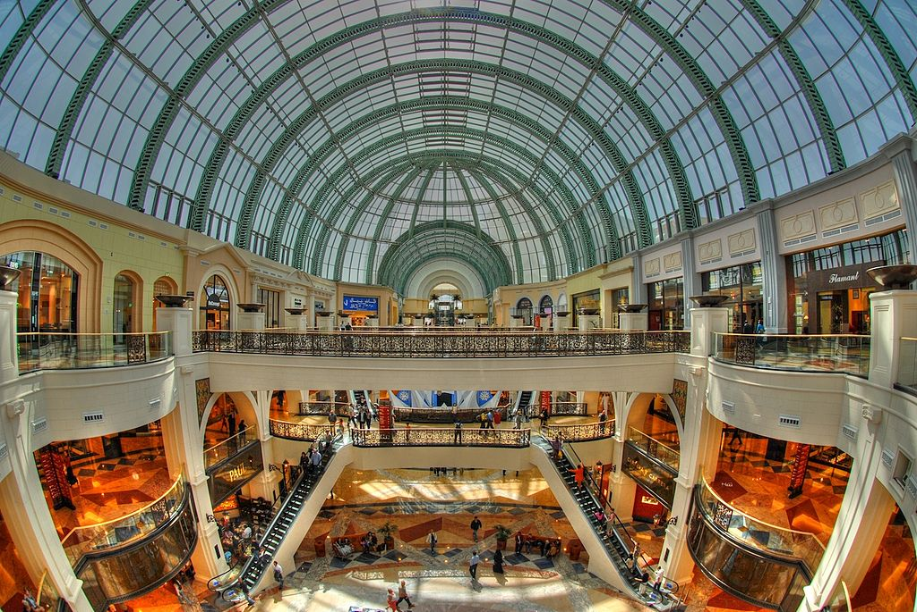
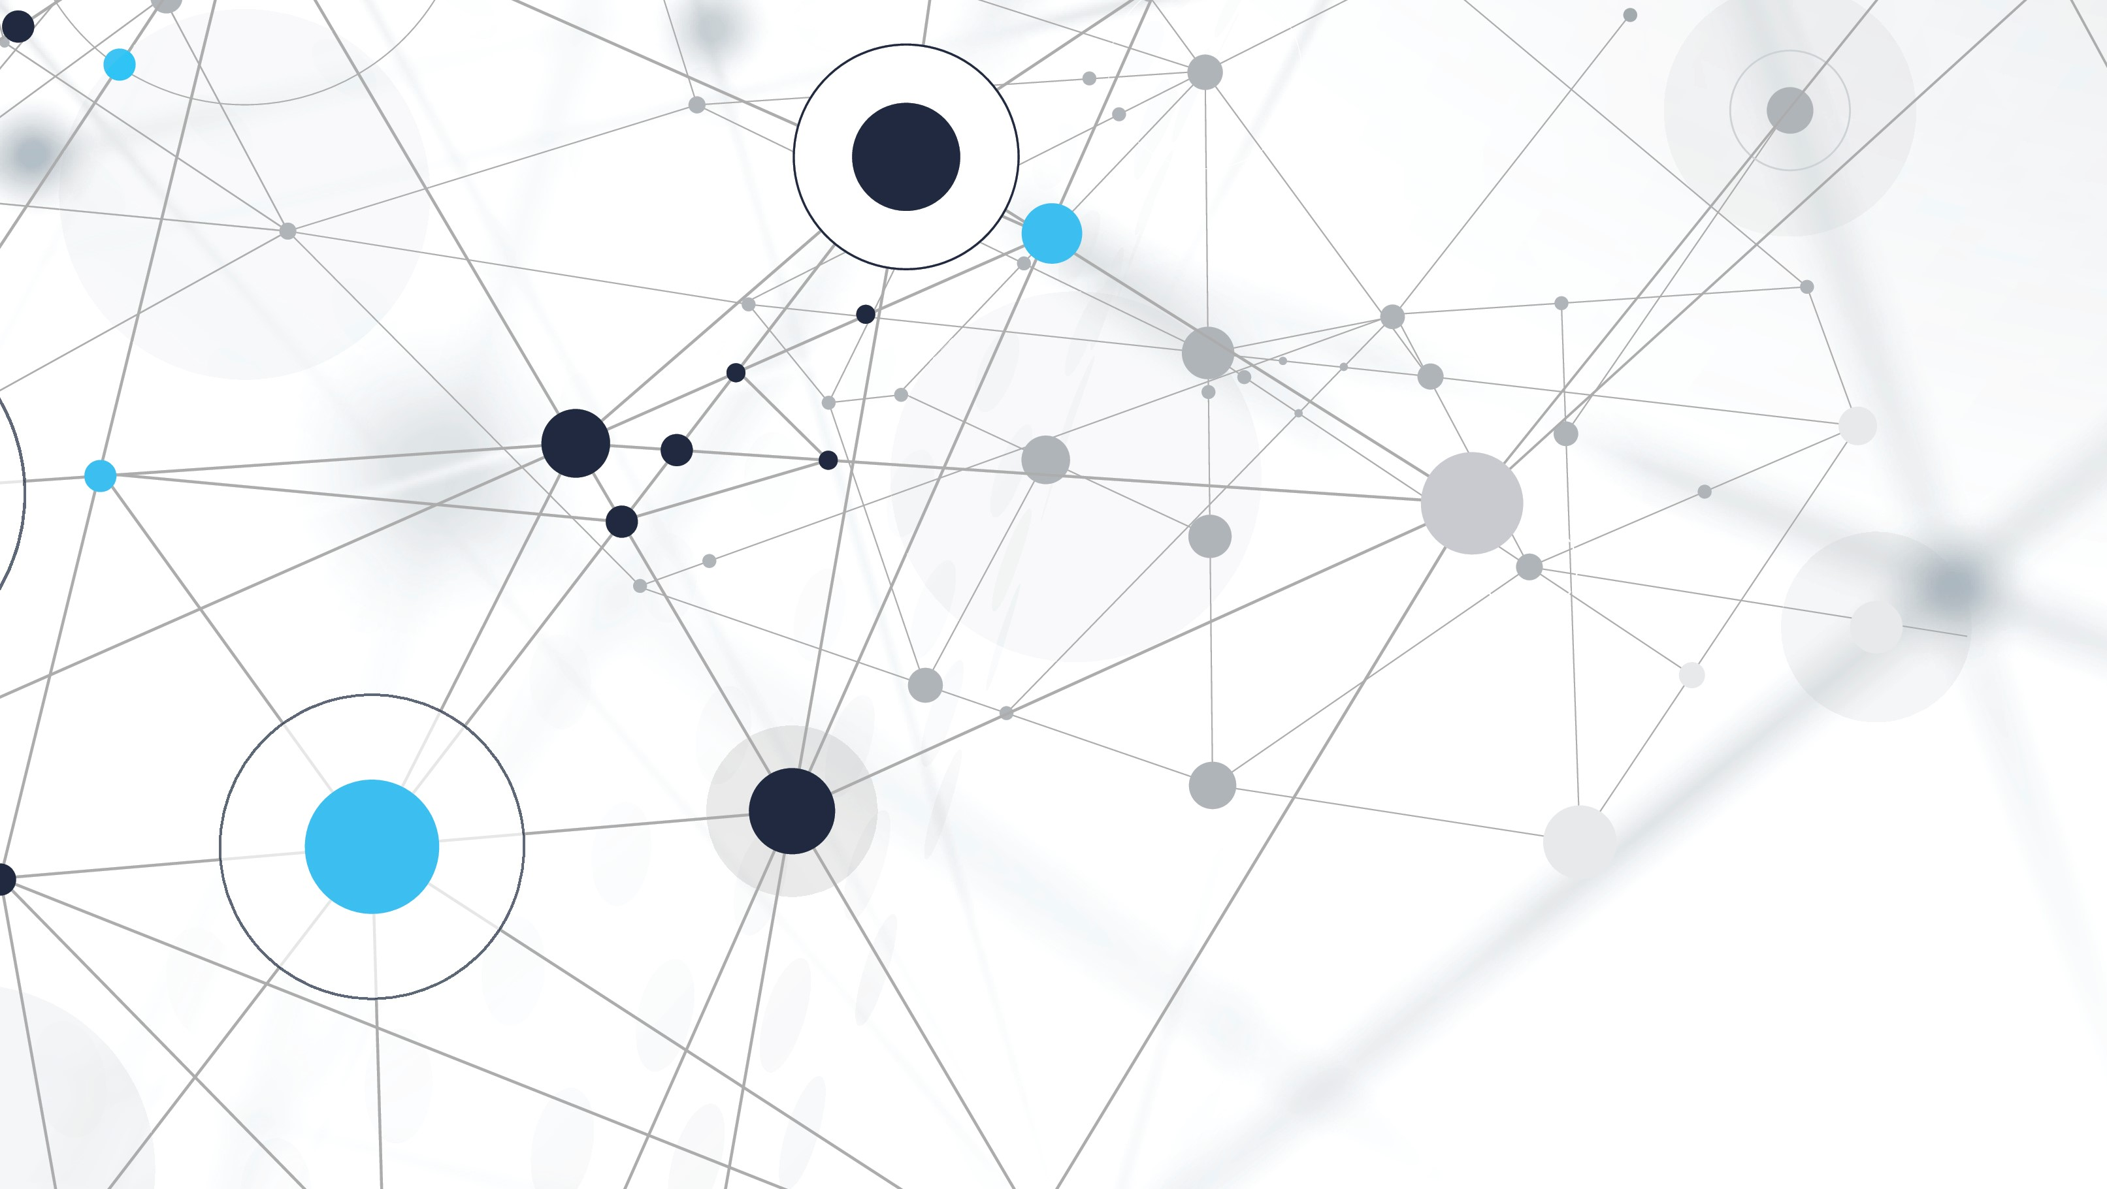
Mall Customer Segmentation Using Unsupervised Learning
DTSA 5510 Unsupervised Algorithms in Machine Learning Final Project

Slide 2
The problem
How can malls tailor marketing to diverse customers?
No predefined customer groups in raw data.
Goal: Segment customers using demographics and spending behavior.

Slide 3
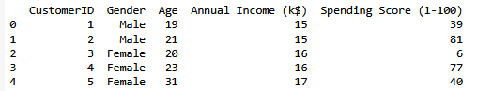
Dataset overview
- Source: Mall Customer Segmentation Data (Kaggle)
- Features: Age, Annual Income, Spending Score, Gender
- Size: 200 records, no missing values

Slide 4
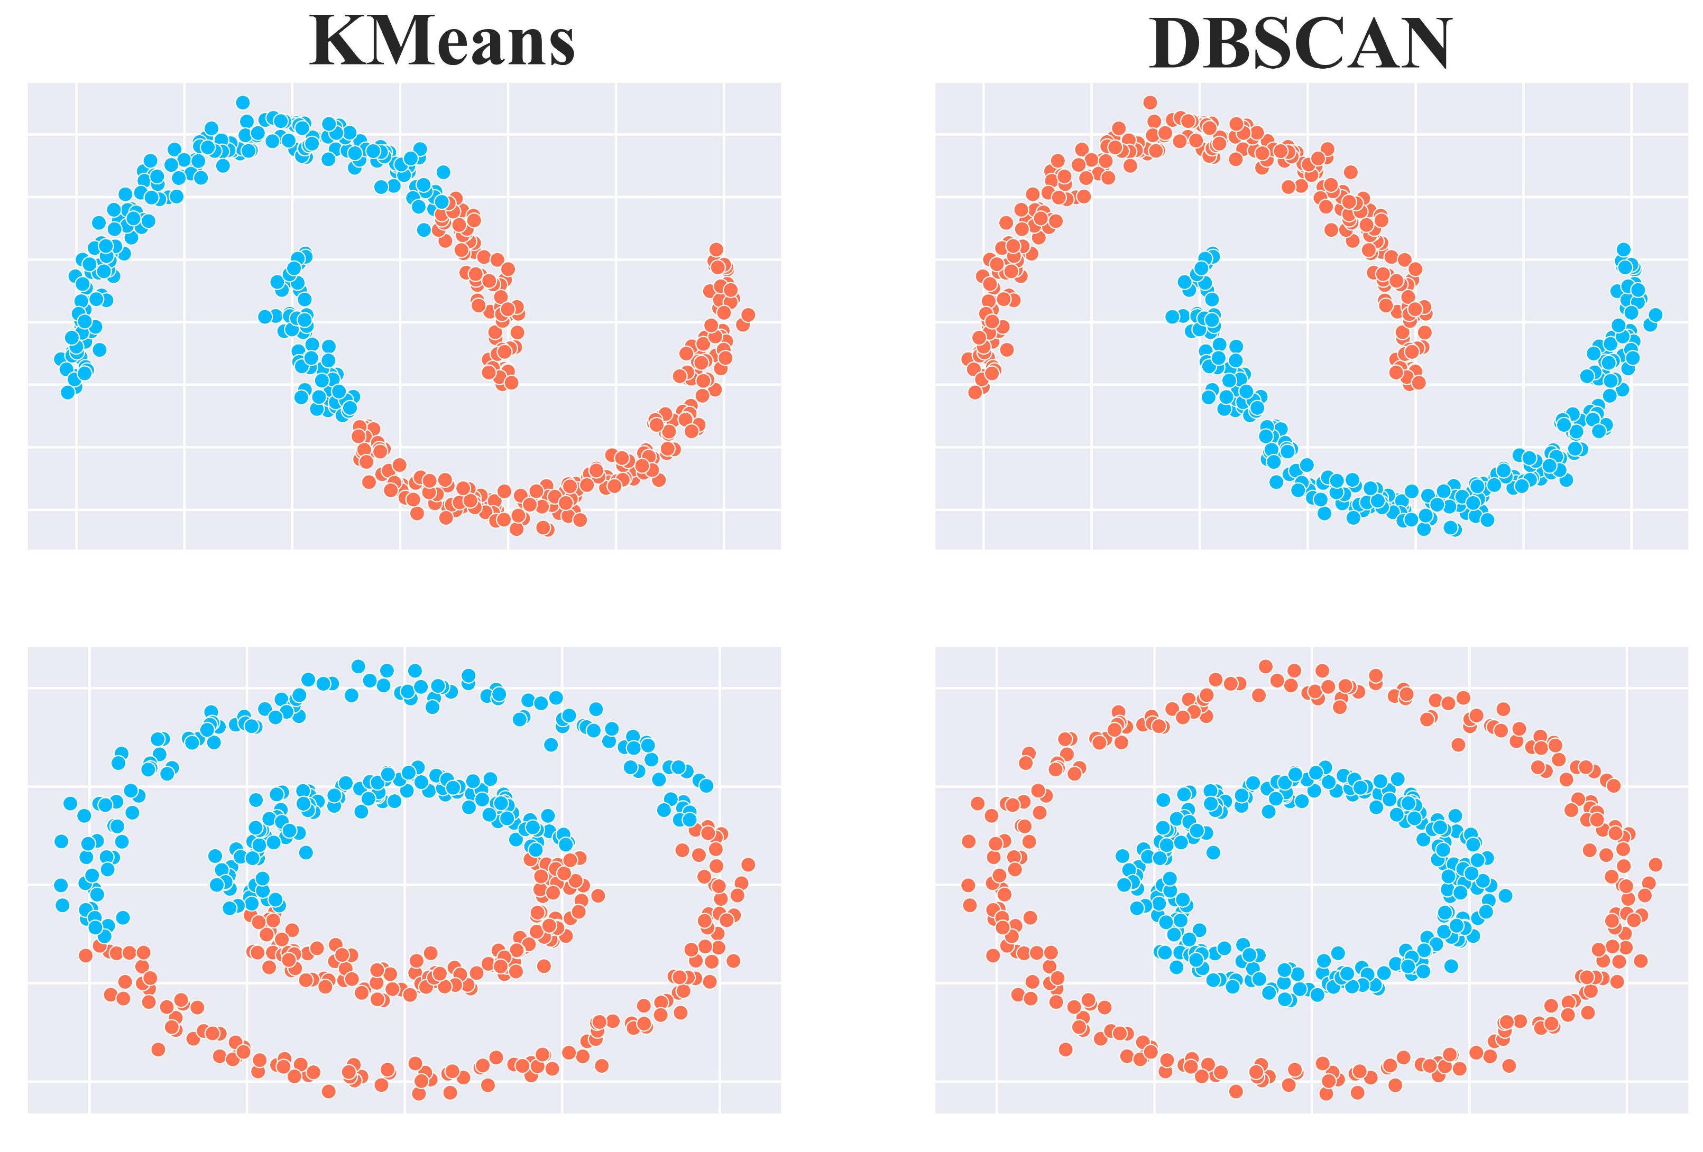
Machine Learning Approach
- Unsupervised Learning: K-means and DBSCAN clustering
- EDA: Visualizations, correlations, scaling
- Hyperparameter Tuning: Elbow method (K-means), eps/min_samples (DBSCAN)
- Evaluation: Silhouette scores
EDA
Preprocessing
Clustering
Evaluation

Slide 5
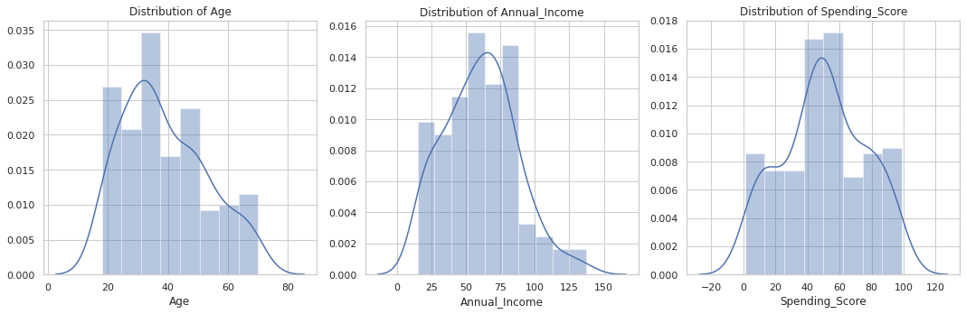
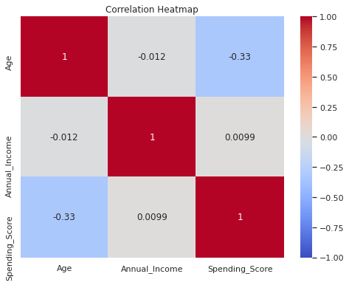
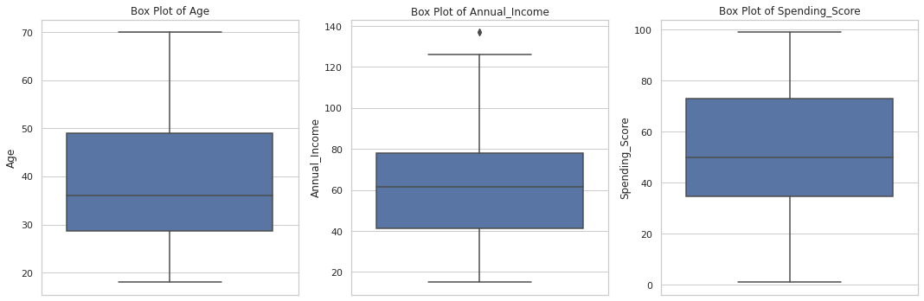
Dataset overview
- Distributions: Age (18-70), Income (15-137k), Spending (1-99)
- Key Finding: Moderate negative correlation between Age and Spending Score
- Preprocessing: Scaled features, encoded Gender

Slide 6
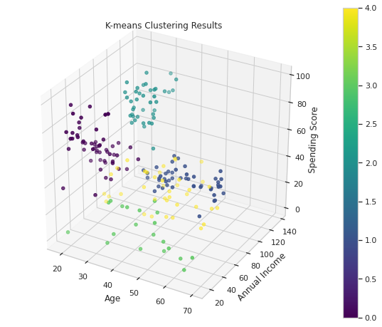
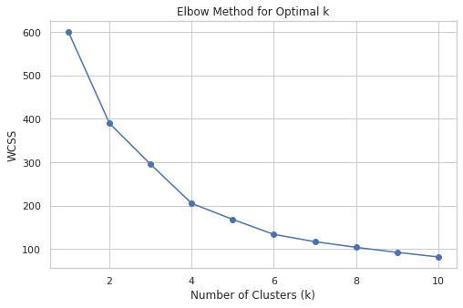
K-means Clustering
- Optimal k=5 (Elbow method)
- Silhouette Score: 0.417
- Segments: Young high-spenders, affluent low-spenders, etc.

Slide 7
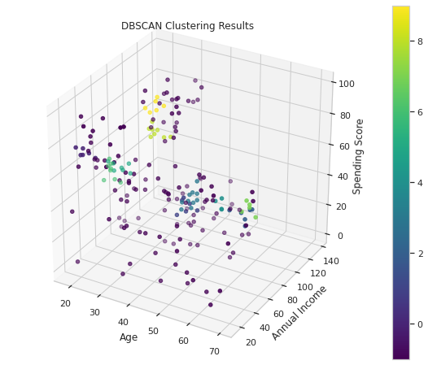
DBSCAN Clustering
- Best: eps=0.3, min_samples=5, 10 clusters
- Silhouette Score: 0.514 (non-noise points)
- Identifies outliers and dense subgroups

Slide 8
Dataset overview
- K-means: Clear, interpretable 5 segments; simpler to implement
- DBSCAN: Higher silhouette score but complex with noise points
- K-means preferred for broad marketing strategies
Model | Silhouette Score | Clusters | Notes
K-means | 0.417 | 5 | Interpretable, spherical
DBSCAN | 0.514 | 10 | Outliers, parameter sensitive

Slide 9

Business Impact
- Cluster 0: Young, high-spending → Trendy promotions
- Cluster 2: Affluent, high-spending → Luxury campaigns
- Cluster 4: High-income, low-spending → Exclusive offers
Example for Cluster 2 campaign

Slide 10
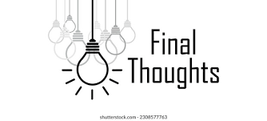
Conclusions
- Successfully segmented customers for targeted marketing
- K-means preferred for simplicity and interpretability
- Future Work: Add features (e.g., purchase frequency), try hierarchical clustering

Slide 11

Q&A
Questions? Thoughts?
Let's Chat! Reach out on Slack or your preferred platform. I'd love to hear from you and have an exchange!

